Slide 1

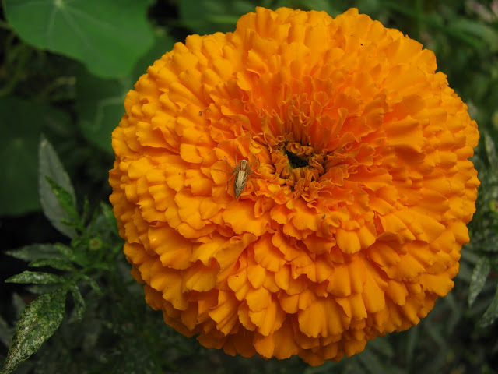
welcome

Slide 2
Introduction
Md Jahangir Alam
Assistant Teacher
Raninagar Garls High School
www.tutul4455@gmail.com
Class:Six
Subject:Englih 1st paper Time: An hour
Date:18-07-13

Slide 3
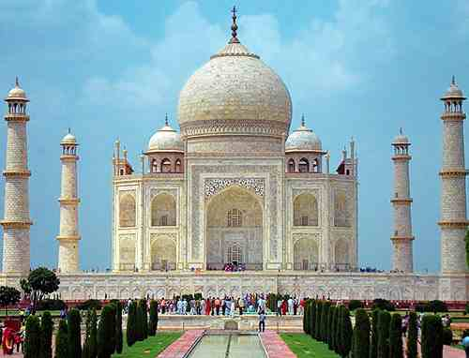
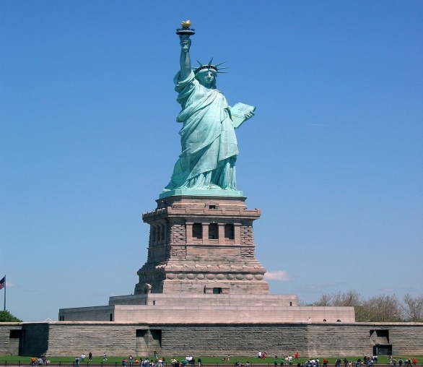
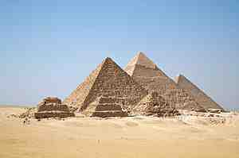
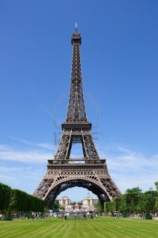
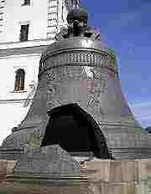
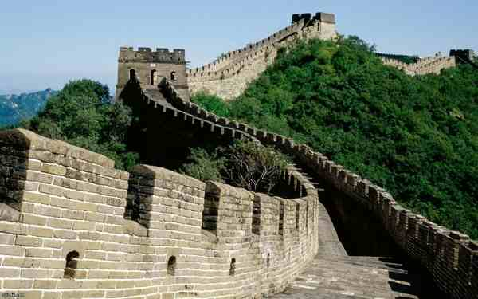
Look at the pictures
What are they called?

Slide 4
Todays topic is
Wonders of the world-1

Slide 5
By the end of the lesson student will be able to
Talk about The Taj Mahal
Location the Taj Mahal
Definition of Pyramid
Talk about The Eiffel Tower
Meaning words on The Eiffel Tower

Slide 6
Tajmahl
The Tajmahal is also known as “the Taj”. It is a white marble tomb located in Agra in India. Do you know the story behind the Taj Mahal?The Mughol Emperor ,Shazahan loved his wife Mumtaj Mahal more than his wife.Mumtaj died at an early age.Shazahan was very shocked at her death.So he built the TajMahal as a token of love for his wife. It is the place where Mumtaj is sleeping forever. The Taj has an area of about 1003 acres or 405 hectars.The TajMahal is the finest example of Mughal architecture.It combinnes the Art of Persia ,Turkey and India.It took 21 years and thousands artisans and craftsmen to complete the TajMahal.The the is Universally admired as one of the wonders of the world.

Slide 7
Now make questions and questions to the answers:
What is …………………………….?
Who build ………………………....?
Known as the Taj
the Taj Mahal
Answer:
1. The Taj Mahal is known as the Taj.
2. Emperot Shah Jahan build the Taj Mahal.

Slide 8
LOOK AT THE PICTURE
Pyramids
The Pyramids are huge tombs for the ancient kings and queens of Egypt.
The most famous Egyptian pyramids are Giza pyramids. Giza is the place near Cairo,the capital of Egypt.

Slide 9
Group works
Fill in the gaps and answer to the question :
Why did he build………………………………….?
How many years it take to……………………?
How was the ……………..…………..…..build ?
4. What ………….…………….………….Pyramids ?
Answer:
Fill in the gaps:
the Taj Mahal, 2. Build it, 3. the Taj Mahal, 4.are the .
Answerto the question:
He build the Taj Mahal as a token of love for his wife .
It took 21 years to build it .
The Taj Mahal was build with whit marble .
4. The Pyramids are huge tombs for the ancient kings and queens of egypt.

Slide 10
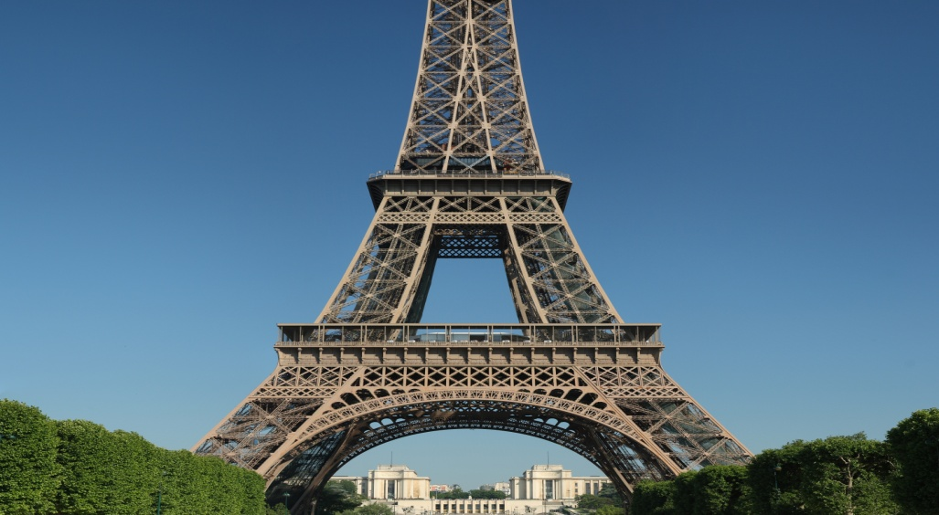
Look at more pictures
Eiffel Tower
The Eiffel Tower is a lattice tower in paris. It was built in 1889. Now it symbolises the cultural icon of France. Its stands as one of the most reconizable structures in the world too. The tower is famous as the tallest constrction in paris and the most-visited paid monument in the world. Millions of people ascend it every year. It is 320 meters (1,050 ) tall, about the same height as and 81-story building.sss
Words: Lattice, Tower, symbolises, reconizable, Famous, Constraction, monument .
Word meaning: Famous=বিখ্যাত, symbolises=প্রতিকায়ন করা

Slide 11
Individual Works:
Write down to the word meaning:
Lattice, Reconizable, Constraction, Monument

Slide 12
Evaluation
Answers to the questions:
1. What is Eiffel tower?
2.What is the height of Eiffel tower?

Slide 13
HOMETASK
Write a paragraph on Eiffel tower.

Slide 14
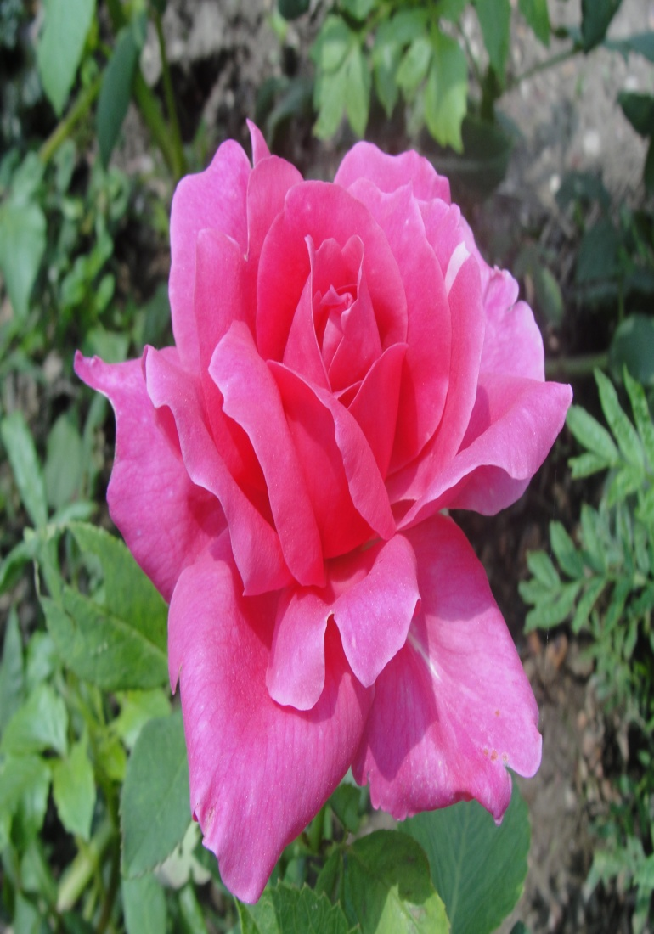
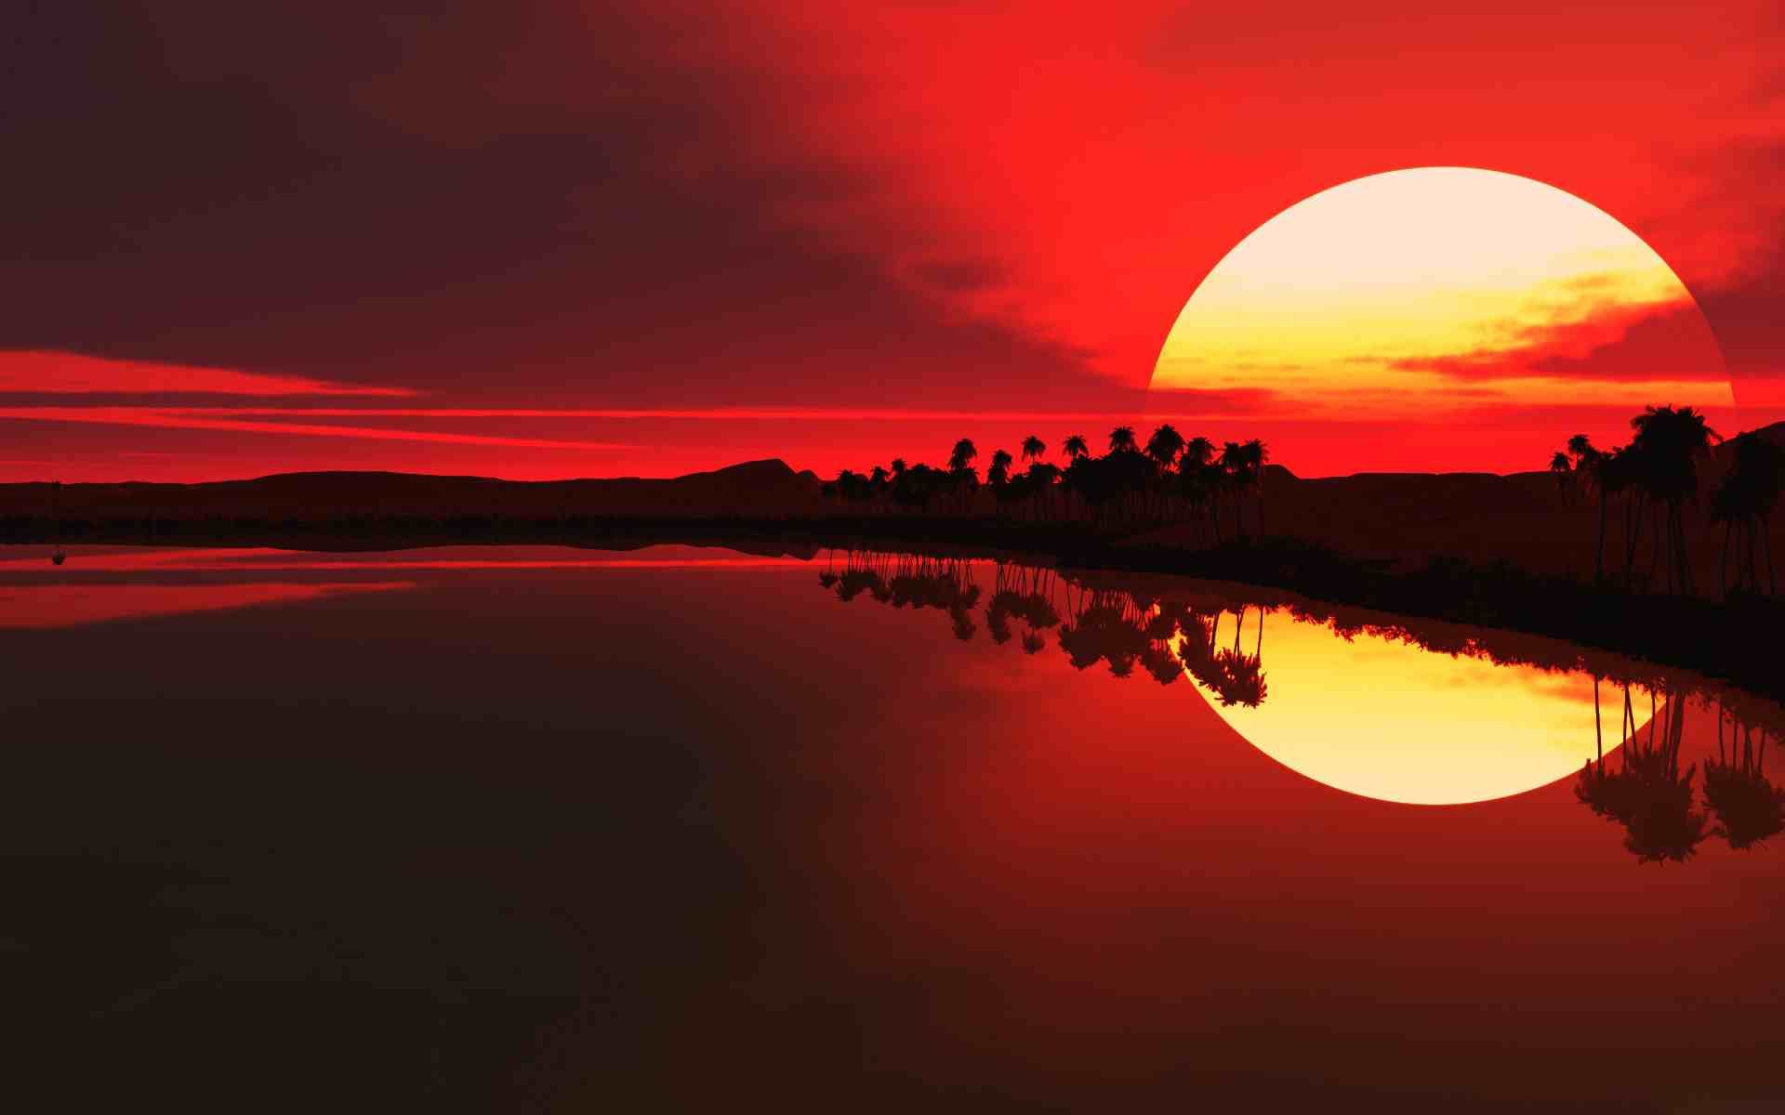
THANK YOU ALL

